Slide 1

CSE499A RESEARCH MID PRESENTATION

Slide 2

GROUP MEMBERS-
Md. Abdur Rakib Rahat
1620521042
Md. Raihan Hossain
1520566642
Sumaya Yeacin Rimu
1530664042
Anwar Shadaab
1611383042

Slide 3
Topic Name: An Analysis to deremine how e-commerce sites implement their business strategies using the dark web and to examine whether it works differently for regular internet e-commerce sites.

Slide 4
Introduction
The dark web is the World Wide Web content that exists on deep nets , overlay networks that use the Internet but require specific software, configurations, or authorization to access. The dark web forms a small part of the deep web, the part of the Web not indexed by web search engines, although sometimes the term deep web is mistakenly used to refer specifically to the dark web.

Slide 5
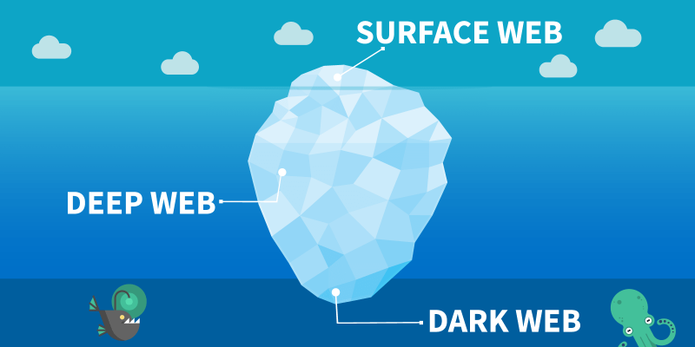

Slide 6
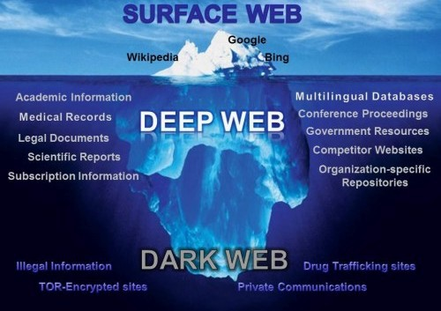

Slide 7
Literature Review:
Critical Analysis of the Emerging Dark Web .
The core objectives of the research study are:
To find out the activities that helped by the dark web in a positive way & negative way.
To identify the ways those reduce the negative impacts of the dark web & using the dark web in a way that is more constructive.
By Abdulmuttaleb Abduljalil
Department of Computing & Information Systems
Cardiff School of Management
Cardiff Metropolitan University

Slide 8
Literature Review:
Archives for the Dark Web: A Field Guide for Study.
Robert W. Gehl
Here author created a catalog of archives of Dark Web:
Software Repositories
Mailing Lists
Forums
Hidden Sites

Slide 9
Literature Review
The not so Dark-side of the darknet: A qualitative Study
Mihnea Mirea · Victoria Wang · Jeyong Jung
This paper reports on a recent research in four Dark Net forums that reveals a different aspect of the Dark Net.

Slide 10
OverView- work done so far
There are so many e-commerce site in dark net.
Dark net marketplace is the market where one can sell or buy products online. In dark net markets the payment mode where made more secure and clear. The dark net markets contain more products listed under many categories and each market have unique products in it.
Mostly the dark net markets contain drugs, weapons, fraud, pirated versions of software etc.
Here are some dark net markets example with links given below:
http://pwoah7foa6au2pul.onion –
Alphabay market – Here you can buy drugs, weapons, chemicals, etc., This is one of the best marketplaces in the dark net.

Slide 11
OverView- work done so far
Dream market-
It was most popular market.But US government shuted down this site at 2008 for security reason.
Samara Market-
Age: 0.3 Years.
No. of Products: 133665
Security Features: 2FA/ Escrow / PGP / Multisig
Currencies Accepted: Bitcoin, Bitcoin Cash, Monero
Vendor Bond: 0.1BTC
Samsara Market stands at the very top of this Darknet Market list for various solid reasons, the prime one being its already established reputation and age, it was established back in 2019 making it one of the oldest standing Darknet Markets.
The second reason being its stock of available products, as of today it has 133665 individual products on the marketplace making it arguably one of the most product-rich Tor markets in the industry.
It’s pretty secure as well allowing for 2-factor authentication using PGP, Multisig payments making sure no one party can move the funds without the approval of at least one other party, as well as a trustworthy and unbiased Escrow.

Slide 12
OverView- work done so far
Berlusconi Market-
Market Overview
Age: N/A
No. of Products: 19325
Security Features: Escrow/ PGP / 2-FA/ 6-digit PIN
Currencies Accepted: Bitcoin/ Monero / Litecoin.
Forum: lokwbo54utdfvr4r
Vendor Bond: 0.04688039 BTC
It’s one of those marketplaces which for some reasons didn’t acquire enough attention or popularity which it very well deserved pertaining to its no. of available products and security features.
It has a total individual listing of 19,325 products which beats the number on WallSt. Market regardless of it being less popular, again it’s mostly dominated by Drugs with over 7,000+ individual listings, it allows nearly everything else including Weapons which is a rarity even for darknet markets.

Slide 13
OverView- work done so far
So far, We tried to reach so many dark websites. But most of them are restricted and to enter those websites we need to use powerful VPN. After a lot of effort we finally got access in two websites which are GREY MARKET & EMPIRE MARKET, We will discuss about these two market below:
EMPIRE MARKET :
It is an alternative market of ALPHABAY.EmpireMarket was formerly known as Omega Bay Market, but then a new market called Omega Market was launched, and the Empire Market team didn’t want to associate themselves with the later, or confuse users between the two and hence re-branded themselves as Empire Market.
Empire Market URL-
The official Empire Market URL is empiremktxgjovhm It has been manually verified and tested by us to be the original, legit URL.

Slide 14
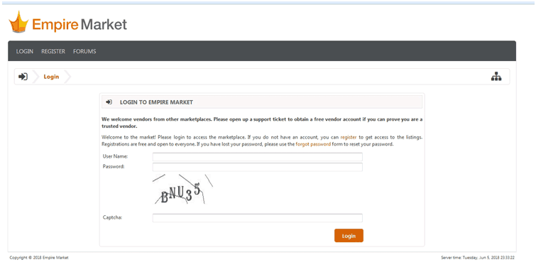
OverView- work done so far

Slide 15
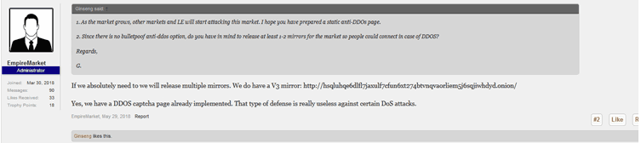
OverView- work done so far
It’s the legit URL which can be verified either from the below screenshot or from this official reply from Empire Market Administrators on the forum.

Slide 16
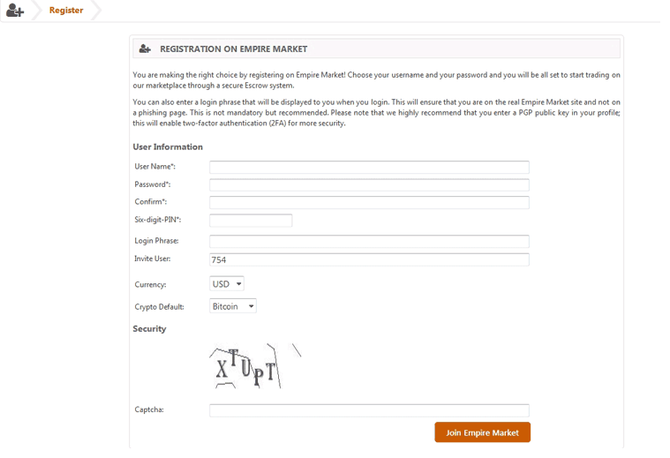
OverView- work done so far
Registration-
The registration process at the marketplace isn’t as short as Dream Market, but it’s still simple and secure

Slide 17
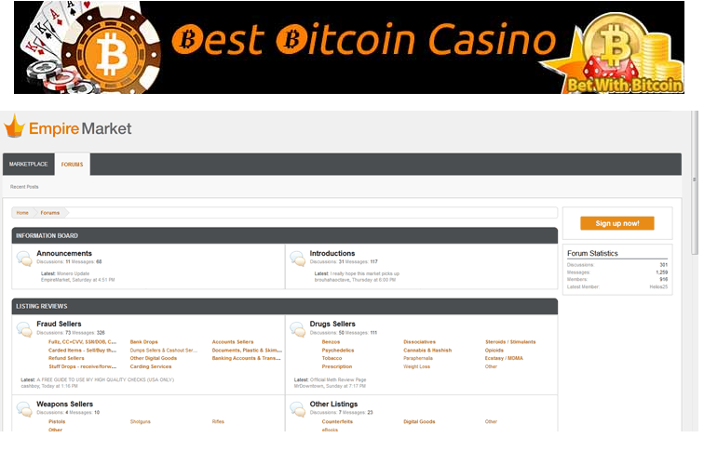
OverView- work done so far
Forum-

Slide 18
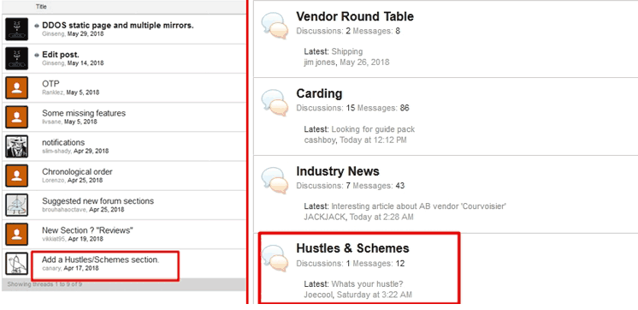
OverView- work done so far
How Effective Is the Forum?
Do admins actually take notice of what people are saying? Well, apparently Empire Market ’s do!
Here’s a screenshot of people asking for a thread called “Hustle and Scheme” on 17th April, 2018.

Slide 19
OverView- work done so far
Then, after so many try we entered the Grey Market. Some information about Grey Market are given below:
Market Overview-
Age: 0.2 Year
No of Products: 600+
Security: PGP, 2FA, Escrow
Currencies Support: Bitcoin, Monero
Registration: Open
Vendor: Yes
If it’s Drugs, Fraud-related goods, Digital Goods or services such as Hacking and Cashouts is what you seek, Grey Market can very well cater to that need. It has a product –stock of 712 products in those categories.
Trades are pretty secure as Escrow is available and it’s a Wallet-less marketplace. PGP is available as well. Payments can be made both via BTC as well as XMR.

Slide 20
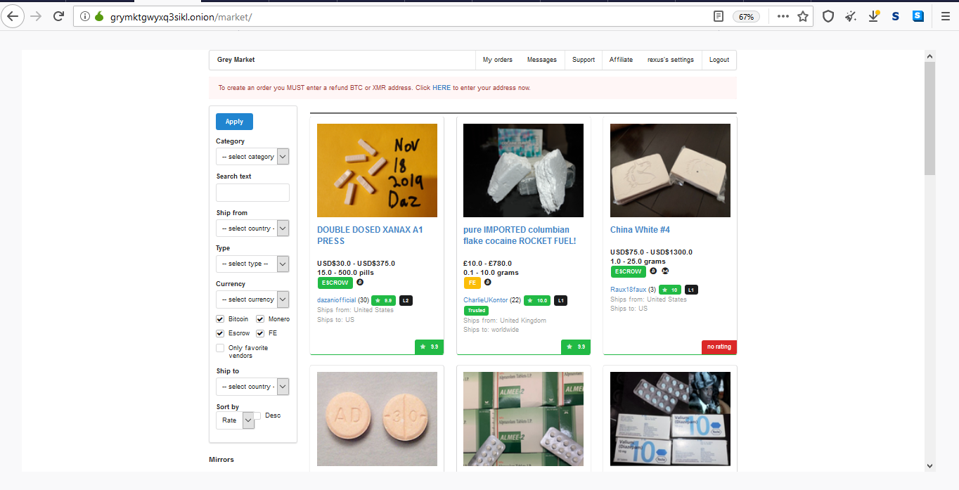
OverView- work done so far

Slide 21
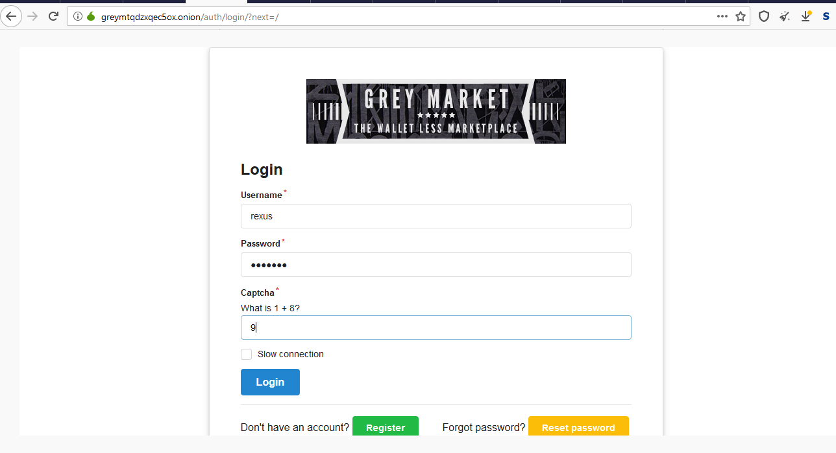
OverView- work done so far

Slide 22
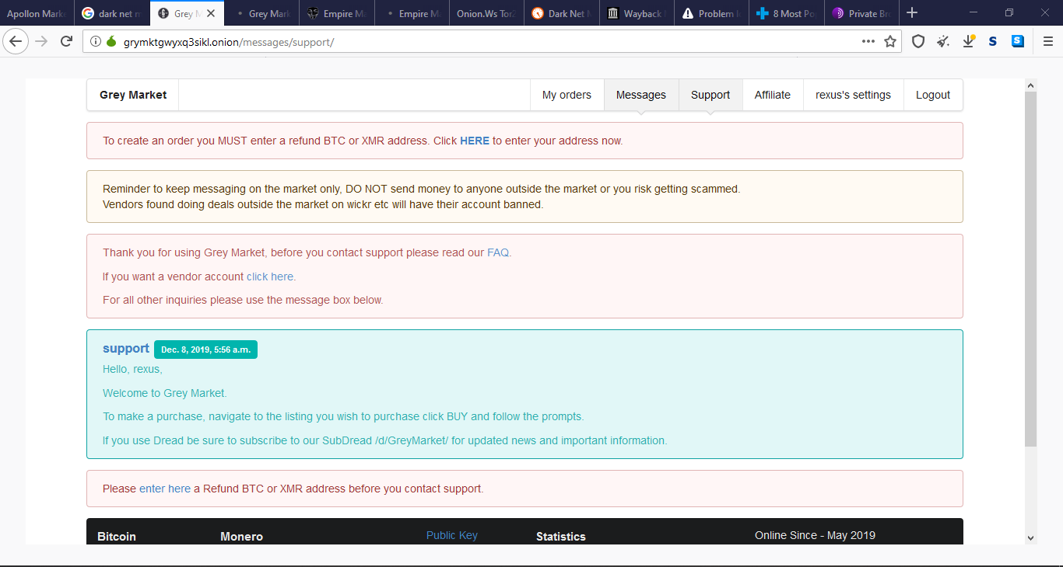
OverView- work done so far

Slide 23
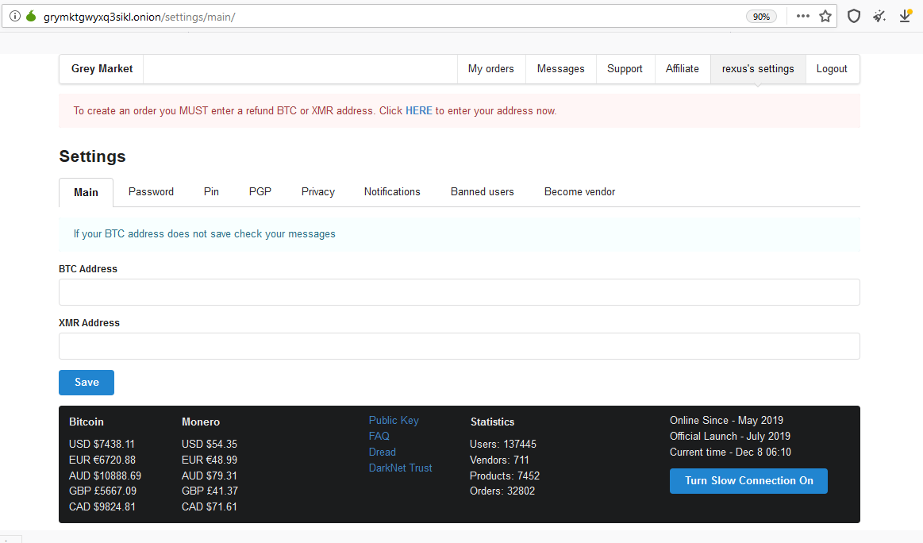
OverView- work done so far

Slide 24
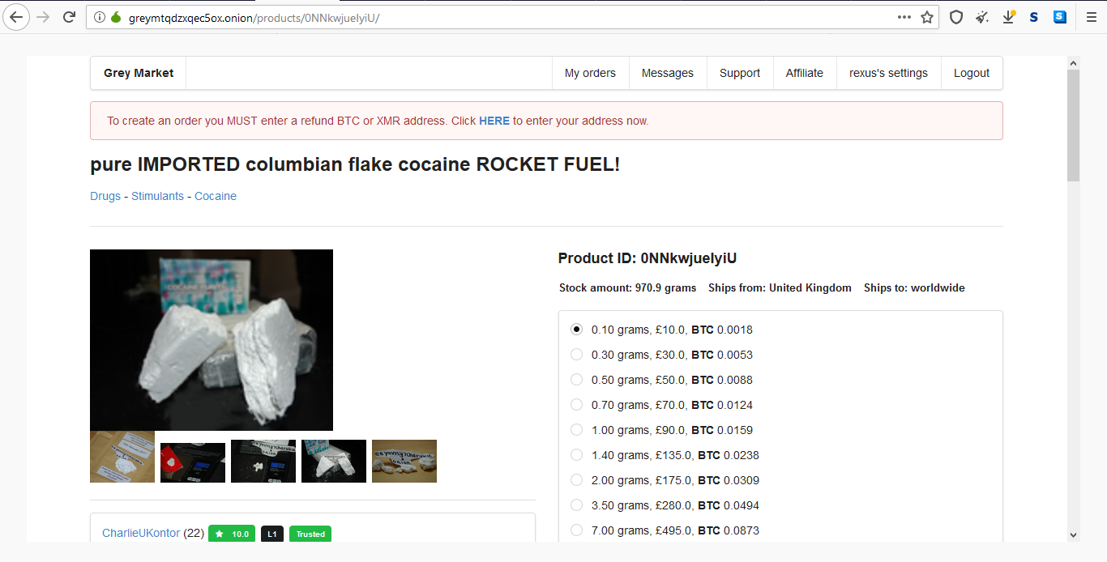
OverView- work done so far

Slide 25
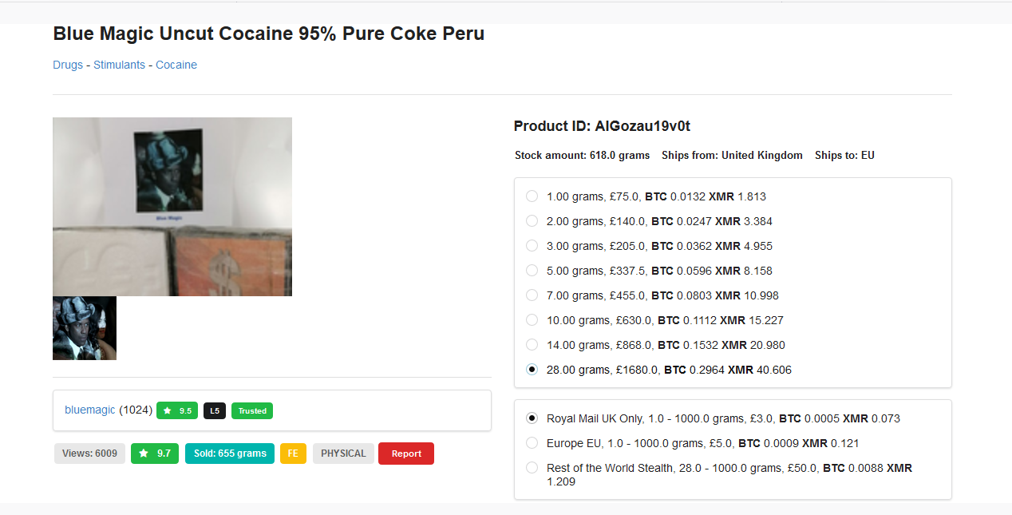
OverView- work done so far

Slide 26
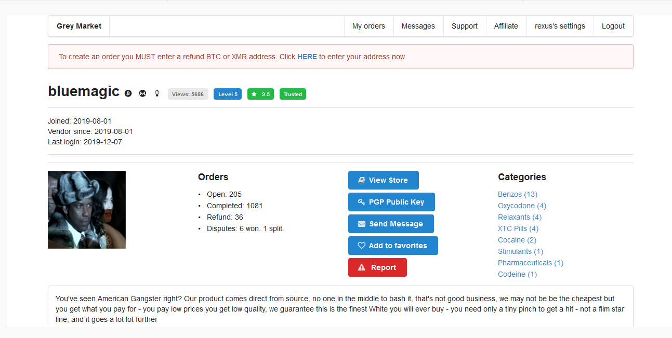
OverView- work done so far

Slide 27
OverView- work done so far
Web Scrapping:
we will try to do web scrapping with Python 4.0 using the library Beautiful soup, urllib. But, we can’t do it successfully.
Because, most of the darkweb’s site are blocked for scrapping. so, we will try it by saving web pages fully completed html.

Slide 28
THANKS!

